Slide 1
Mean
Arithmetic Mean
Weighted Mean
Harmonic Mean
Geometric Mean

Slide 2
What is Mean?
In statistics, the mean is a measure of central tendency, representing the average value of a dataset.
It gives us an idea of where the center of the data lies, helping summarize large sets of numbers with a single value.

Slide 3
How to Calculate the Mean
The mean (often referred to as the arithmetic mean) is calculated by:
Adding up all the values in the dataset.
Dividing the total by the number of values.
Formula:
Mean=∑X\N
​Where:
∑X is the sum of all data points.
N is the number of data points.

Slide 4
Example
Suppose we have the following five numbers: 4, 8, 10, 12, 6.
Add all the numbers together:
4+8+10+12+6=40
Divide by the total number of values (which is 5):
40/5=8
So, the mean of these numbers is 8.

Slide 5
Mean in Real-Life Example
Imagine a class of 5 students takes a math test, and their scores are:
75, 85, 90, 95, 80
To find the mean score (average score of the class):
Add the scores together:
75+85+90+95+80=425
Divide by the number of students (which is 5):
425/5=85
The mean score of the class is 85, meaning on average, the class performed at an 85.

Slide 6
The Mean as a Balancing Point (Another Analogy)
Think of the mean as the balance point of a seesaw:
Imagine a seesaw with kids of different weights sitting at various points.
If you want the seesaw to balance, you need to find a position where the combined weight of everyone is perfectly balanced on both sides.
The mean is like this balancing point. It's the spot where, if you think of all the data points (or weights) spread out, they would perfectly balance around that center value.

Slide 7
Types of Means
While the arithmetic mean is the most common, there are other types of means for different purposes:
Weighted Mean: If some values are more important than others (like in weighted grades), you multiply each value by its weight before calculating the mean.
Geometric Mean: Used for datasets involving multiplicative processes, like growth rates (e.g., population growth).
Harmonic Mean: Often used in averaging rates or ratios (e.g., speeds).

Slide 8
Pros and Cons of the Mean
Pros:
Easy to calculate: The formula is simple and intuitive.
Represents central tendency: Gives a good idea of the overall level of the data.

Slide 9
Cons
Sensitive to outliers: The mean can be heavily influenced by extreme values. For example, if one student scored much higher or lower than the others, it could skew the mean.
Example of Outliers: If we have salaries like $40,000, $42,000, $45,000, $50,000, $500,000, the mean would be misleading:
The sum of these salaries is $677,000.
Divided by 5, the mean is $135,400.
But this mean doesn’t accurately reflect the typical salary because the $500,000 is an outlier that inflates the mean.

Slide 10
What is Weighted Mean?
A weighted mean (also called a weighted average) is a variation of the arithmetic mean, where some values in the dataset are given more importance or weight than others.
Instead of treating each data point equally, the weighted mean takes into account the relative significance of each value.
This is useful when certain data points are more important than others, or when they represent larger groups or quantities.

Slide 11
How to Calculate the Weighted Mean
Multiply each value by its weight.
Add up the products.
Divide the total by the sum of the weights.

Slide 12
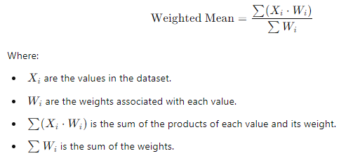
Formula
The weighted mean is calculated as:

Slide 13
Example
Suppose you are a student, and your final grade depends on the following scores and their respective weights:
Homework: 85 (weight = 20%)
Midterm Exam: 90 (weight = 30%)
Final Exam: 80 (weight = 50%)
To calculate the weighted mean:
Multiply each score by its corresponding weight (expressed as a decimal):
(85×0.20)+(90×0.30)+(80×0.50)
=17+27+40
=84
The total weight is 0.20+0.30+0.50=1, so no further division is needed.
Thus, the weighted mean score is 84.

Slide 14
Analogy
Imagine you are buying different bags of fruit from a market:
You buy 2 pounds of apples at $3 per pound. You buy 5 pounds of bananas at $1 per pound. You buy 3 pounds of oranges at $4 per pound.
To find the average price per pound of fruit, you need to weight the prices by the quantities you bought.
Multiply the price of each fruit by the quantity:
Apples: 2×3 =6
Bananas: 5×1=5 =5
Oranges: 3×4=12
Add up the total cost:
6+5+12=23
Add up the total weight:
2+5+3=10
Divide the total cost by the total weight to get the weighted mean price:
23/10=2.3 dollars per pound
So, the weighted mean price is $2.30 per pound.

Slide 15
Why Use the Weighted Mean?
More accurate representation: In situations where not all data points are equally important (like exams with different importance levels or stocks with different market shares), the weighted mean gives a more accurate average.
Real-world scenarios: Weighted means are frequently used in finance, education, economics, and more, where some values inherently carry more significance.

Slide 16
Weighted Mean vs. Arithmetic Mean
The arithmetic mean treats all values equally, which might not always give the most meaningful result when some values should carry more importance.
The weighted mean assigns different levels of importance to each value, giving a more nuanced and accurate reflection of the dataset.

Slide 17
Example
Imagine a situation where you are calculating the average of two tests, one from a small quiz (worth 10%) and one from the final exam (worth 90%). If a student scores 60 on the quiz and 80 on the exam, the arithmetic mean would be:
60+80/2=70
But this ignores the fact that the final exam is much more important. The weighted mean would be:
(60×0.10)+(80×0.90)=6+72=78
So, the weighted mean gives a more accurate representation of the student's performance, which in this case is 78 rather than 70.

Slide 18
What is Harmonic Mean?
The harmonic mean is a type of average that is especially useful when you want to average rates or ratios.
Unlike the arithmetic mean, which simply adds values and divides by the count, the harmonic mean gives more weight to smaller values.
It is most appropriate in situations where you need to average quantities like speed, efficiency, or other rates.

Slide 19

Formula
The harmonic mean of n numbers X1,X2,X3,…,Xn​ is given by the formula:
Where:
n is the total number of data points.
Xi​ represents each individual data point.

Slide 20
Key Idea
The harmonic mean is used when you want to calculate an average in a context where each value is a rate (e.g., speed, density), or when the values have an inverse relationship.

Slide 21
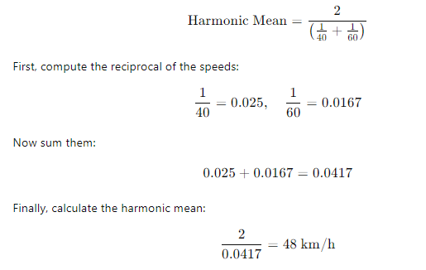
Example 1: Average Speed
Suppose you drive a car for two equal distances but at different speeds. For example, you drive 60 km at 40 km/h and another 60 km at 60 km/h. To find the average speed over the entire journey, the harmonic mean is appropriate.

Slide 22
Why Use the Harmonic Mean?
The harmonic mean is useful when:
You are working with rates or ratios, like speed or production rates.
You want to give more weight to smaller values in your dataset.
You’re averaging variables that are inversely related to the quantity of interest.

Slide 23
Harmonic Mean vs. Arithmetic Mean
The arithmetic mean is simply the sum of the values divided by the number of values and is appropriate when all values are equally significant.
The harmonic mean gives more weight to smaller values and is particularly useful when dealing with rates or ratios.

Slide 24
What is Geometric Mean?
The geometric mean is another type of average, and it’s particularly useful when you're dealing with data that involves growth rates, percentages, or multiplicative relationships.
Unlike the arithmetic mean, which sums values and divides by their count, the geometric mean multiplies values and then takes the root of that product.

Slide 25
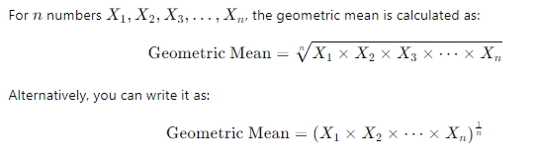
Formula

Slide 26
Key Idea
The geometric mean is used when you want to calculate the average rate of change or growth. It's especially relevant in finance (for investment returns), science (for population growth), and any context where you're dealing with rates or percentages.

Slide 27
Example 1: Investment Growth
Suppose you invest $1,000 in a fund, and the returns over three years are:
Year 1: 10% growth
Year 2: 20% growth
Year 3: -5% (a loss)
To calculate the average annual growth rate over these three years, the geometric mean is the best option.

Slide 28
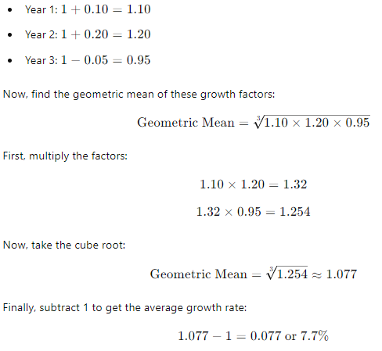
So, the average annual growth rate over the three years is 7.7%, which is more accurate than the arithmetic mean in this case because it accounts for the compounding effect of the rates.

Slide 29
Summary
The geometric mean is the best average to use when you’re dealing with growth rates, percentages, or any process that involves multiplicative relationships.
It’s calculated by multiplying all the values and then taking the root (depending on the number of values).
The geometric mean smooths out the extremes and gives a better overall picture in situations like investment returns, population growth, or averaging rates.
It gives more balanced weight to smaller values, making it more useful in cases where one large value can disproportionately influence the result, as in the arithmetic mean.
The geometric mean is essential for situations where values grow or change multiplicatively, such as financial investments or population dynamics.

Slide 30
Rate vs. Rate of Change
Rate:
A rate describes how one quantity changes with respect to another, typically over a fixed period or distance. It's a ratio between two things.
Common examples of rate include speed (distance over time, e.g., 60 km/h) or flow rate (volume over time, e.g., liters per minute).
Harmonic mean is ideal for averaging rates because it emphasizes the reciprocal relationship between quantities. The harmonic mean balances out situations where the time spent or resource usage at lower rates significantly affects the overall outcome.

Slide 31
Rate of Change
A rate of change is the change of a quantity over time or another variable. It focuses on the percentage change or growth over time, not just the static ratio between two things. It describes how fast something is increasing or decreasing.
Common examples of rate of change include growth rate (e.g., population or investment growth) and percentage increase/decrease in stock prices, sales, or population.
Geometric mean is more appropriate for rate of change because it accounts for the multiplicative effect over time. In cases where you’re compounding growth (or decline), the geometric mean gives a better average since each period’s change affects the next one.

Slide 32
Harmonic Mean and Rate
The harmonic mean works best for averaging rates, especially when the rates are combined over equal distances or time periods, and you want to account for the time spent at different rates. It effectively handles situations where lower rates have a larger impact on the overall result.

Slide 33
Example (Harmonic Mean and Rate)
Suppose you're calculating the average speed for a trip where you drove:
60 km/h for the first half of the journey, and
40 km/h for the second half.
Since the harmonic mean focuses on the reciprocal of the rates, it gives more weight to the slower speed (40 km/h), which takes more time. This results in a lower average than if you used the arithmetic mean. Here, we are dealing with fixed rates over a constant distance, so the harmonic mean is appropriate.

Slide 34
Geometric Mean and Rate of Change
The geometric mean, on the other hand, is ideal for averaging rate of change or growth rates, where the growth (or decay) compounds over time. Each period's rate of change affects the next, so the geometric mean balances out multiplicative effects across periods.

Slide 35
Example (Geometric Mean and Rate of Change)
Imagine you have an investment that grows:
20% in the first year,
15% in the second year, and
30% in the third year.
The geometric mean accounts for how each year's growth builds on the previous year's total. If you averaged these percentages arithmetically, you wouldn't capture the compounding nature of the growth. The geometric mean, however, reflects the average rate of change over multiple periods, considering how each period affects the next.

Slide 36
Key Differences
Rate: Describes a fixed relationship between two variables (e.g., distance over time). The harmonic mean gives more weight to lower rates to account for their larger impact on the total time or resource usage.
Rate of Change: Describes how a quantity changes over time or another variable (e.g., growth rate, percentage increase). The geometric mean accounts for compounded changes and balances the overall growth rate over time.

Slide 37
How They Relate to Means
Harmonic Mean: Best for rates (e.g., speed, efficiency). It emphasizes smaller rates because they disproportionately affect the total outcome, especially when combined over time or distance.
Geometric Mean: Best for rates of change (e.g., growth rates, investment returns). It averages multiplicative effects across multiple periods, making it ideal for calculating compound growth or decay.

Slide 38
Arithmetic Mean Example Questions for Ungrouped Data

Slide 39
Question 1
A survey of salaries (in thousands) of recent graduates at a company shows the following salaries: 45, 52, 48, 55, 60, 58, 62, 47, 50, 61. After reviewing the data, it’s found that the salary of 55 was incorrectly recorded and should actually be 59. Calculate the corrected arithmetic mean salary of the graduates.

Slide 40
Solution for Question 1:
Original salaries: 45,52,48,55,60,58,62,47,50,61
Corrected salary data: 45,52,48,59,60,58,62,47,50,61
Sum of corrected data:
45+52+48+59+60+58+62+47+50+61=542
Arithmetic mean:
54/210=54.2
Answer: The corrected arithmetic mean salary is $54,200.

Slide 41
Question 2
A scientist records the weight (in grams) of 12 samples as follows: 23.5, 21.7, 24.8, 22.3, 25.1, 21.9, 24.5, 23.8, 22.9, 24.2, 23.1, and 22.6. After double-checking, they realize that the last weight recorded as 22.6 was actually 23.0. Find the corrected arithmetic mean weight of the samples.

Slide 42
Solution for Question 2
Solution for Question 2:
Original weights: 23.5,21.7,24.8,22.3,25.1,21.9,24.5,23.8,22.9,24.2,23.1,22.6
Corrected weight data: 23.5,21.7,24.8,22.3,25.1,21.9,24.5,23.8,22.9,24.2,23.1,23.0
Sum of corrected data:
23.5+21.7+24.8+22.3+25.1+21.9+24.5+23.8+22.9+24.2+23.1+23.0=281.8
Arithmetic mean:
281.8/12≈23.48
Answer: The corrected arithmetic mean weight is approximately 23.48 grams.

Slide 43
Arithmetic Mean Example Question for Grouped Data
Question: The following data shows the distribution of scores in a test:
Score Range: 10-20, 20-30, 30-40, 40-50, 50-60
Frequency: 5, 8, 12, 7, 3

Slide 44

Solution for Question 1 Grouped Data
Solution for Question 1:
Calculate the midpoint ($x_{i}$) for each score range:
10−20 : midpoint = 15
20−30 : midpoint = 25
30−40 : midpoint = 35
40−50 : midpoint = 45
50−60 : midpoint = 55

Slide 45
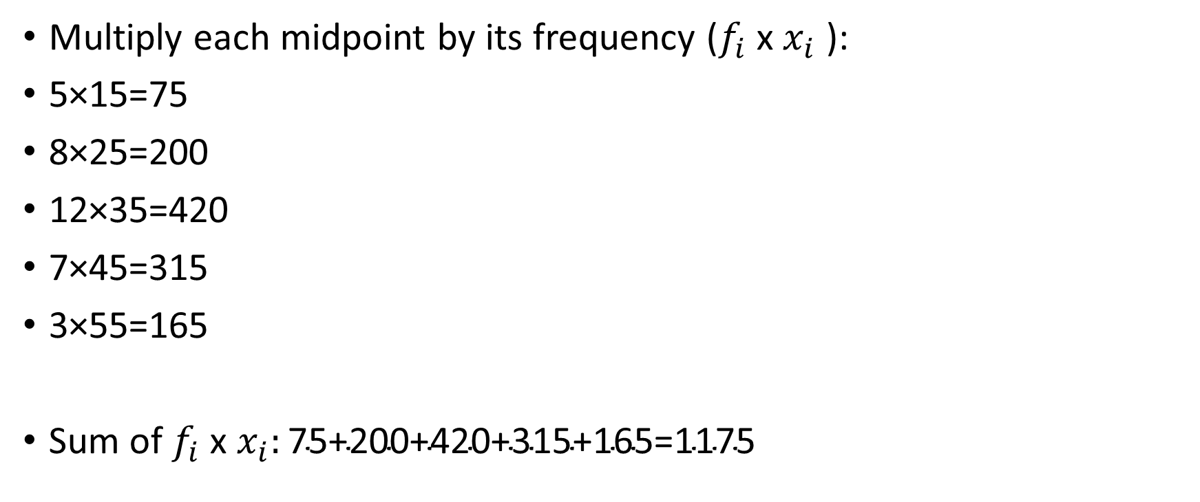
Multiply each midpoint by its frequency ($f_{i}$​ x $x_{i}$​ ):
5×15=75
8×25=200
12×35=420
7×45=315
3×55=165
Sum of $f_{i}$​ x $x_{i}:\text{75+200+420+315+165=1175}$

Slide 46
Arithmetic mean:
1175/35=33.57
Answer: The arithmetic mean score is approximately 33.57.

Slide 47
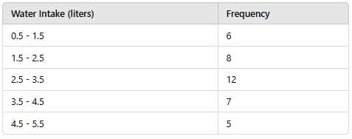
Arithmetic Mean Example Problem with Fractional Values
A group of people were surveyed about the amount of water (in liters) they drink per day. The data is summarized as follows:
Calculate the arithmetic mean water intake.

Slide 48
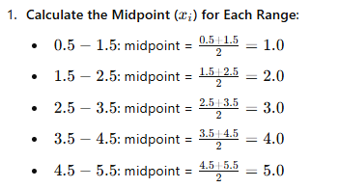
Solution

Slide 49
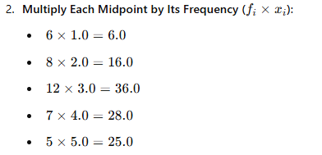

Slide 50
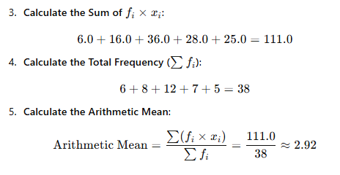

Slide 51
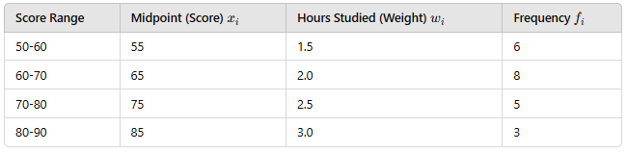
Example: Weighted Mean with Grouped Data
Suppose a teacher wants to calculate the weighted mean score for a test. The class is divided into groups based on scores, and each group has a different weight based on the number of hours they studied. Here’s the data:

Slide 52
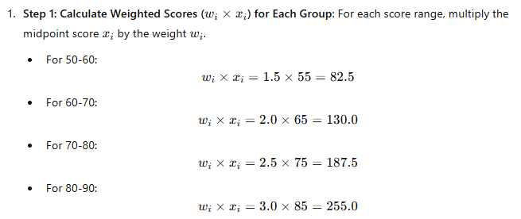
Step-by-Step Solution

Slide 53
Step 2: Calculate the Sum of Weighted Scores:

Slide 54

Step 3: Sum the Weights:

Slide 55
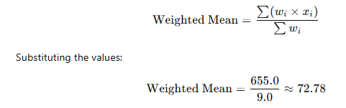
Step 4: Calculate the Weighted Mean: The formula for the weighted mean is:
Answer:
The weighted mean score for the test is approximately 72.78.

